Slide 1
LIMO BASIC STATS
Cyril Pernet

Slide 2
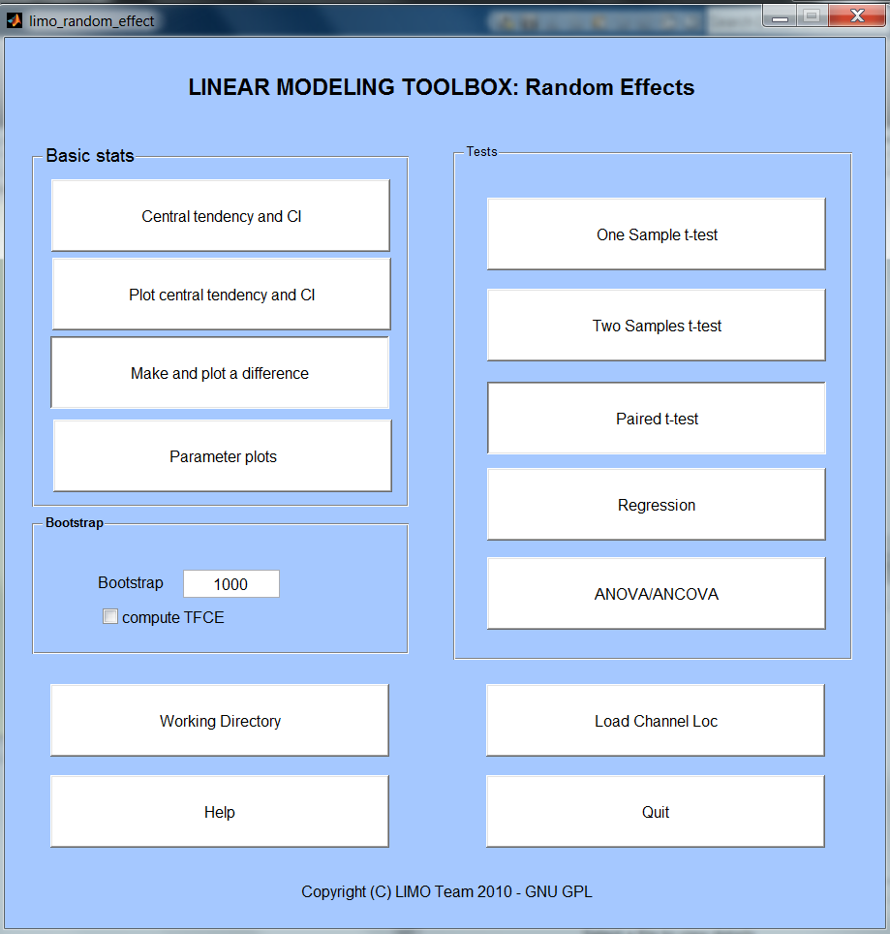
LIMO BASIC STATS
Under the Random effect GUI because of dealing within and between subjects’ data.

Slide 3
LIMO BASIC STATS
The central tendency and CI button allows performing 'averages' of data (either single trials for a subject or parameters across groups). This is called central tendency because you can choose to use standard means (or weighted if available) but also trimmed means, median or Harell Davis estimators. In each case a robust confidence interval is provided → Plot central tendency and CI
Make and plot a difference allows computing the difference between two data set and plot this difference with bootstrapped confidence intervals (not corrected for multiple comparisons).
Parameter plots: also to do standard box plots or correlation analyses.

Slide 4
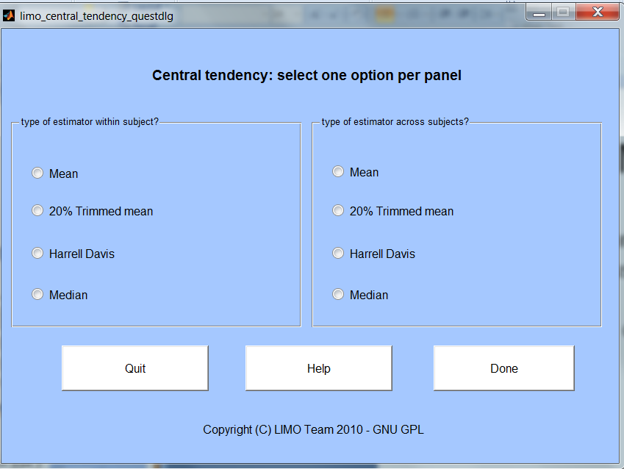
central tendency and CI
Compute estimators of central tendency: (weighted) mean, trimmed mean (i.e. Remove 20% lowest values and 20% highest values), Mid-Decile Harrell Davis or Median
Computed at subject (i.e. across trials) and group (i.e. across subjects) level

Slide 5
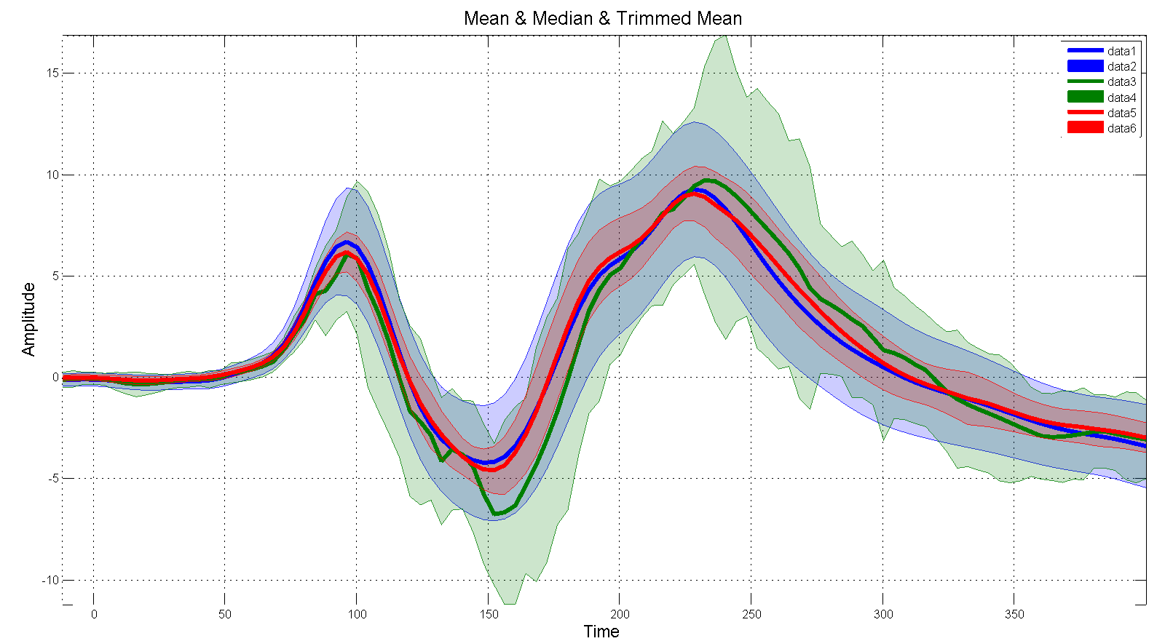
Plot central tendency and CI
Add results from computations to a single plot allowing, eg. to plot X conditions, or for a given condition mean vs. trimmed mean vs. median

Slide 6
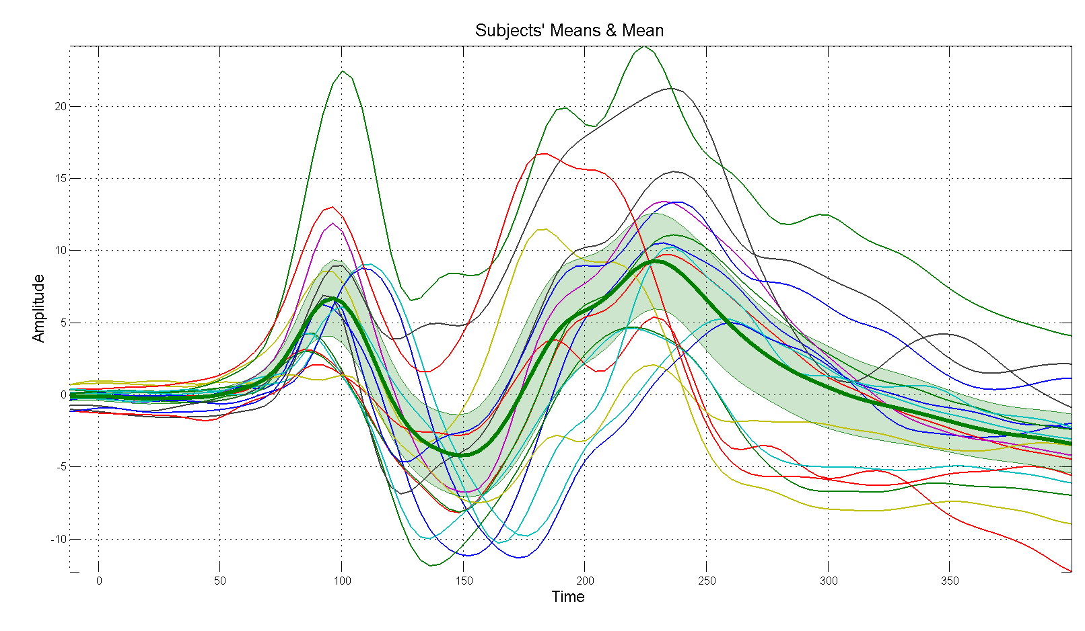
Plot central tendency and CI
Also quite useful to visualize if, at the group level, an estimator captures well subjects differences
Here, the mean across subjects doesn’t capture well the subjects’ variability

Slide 7
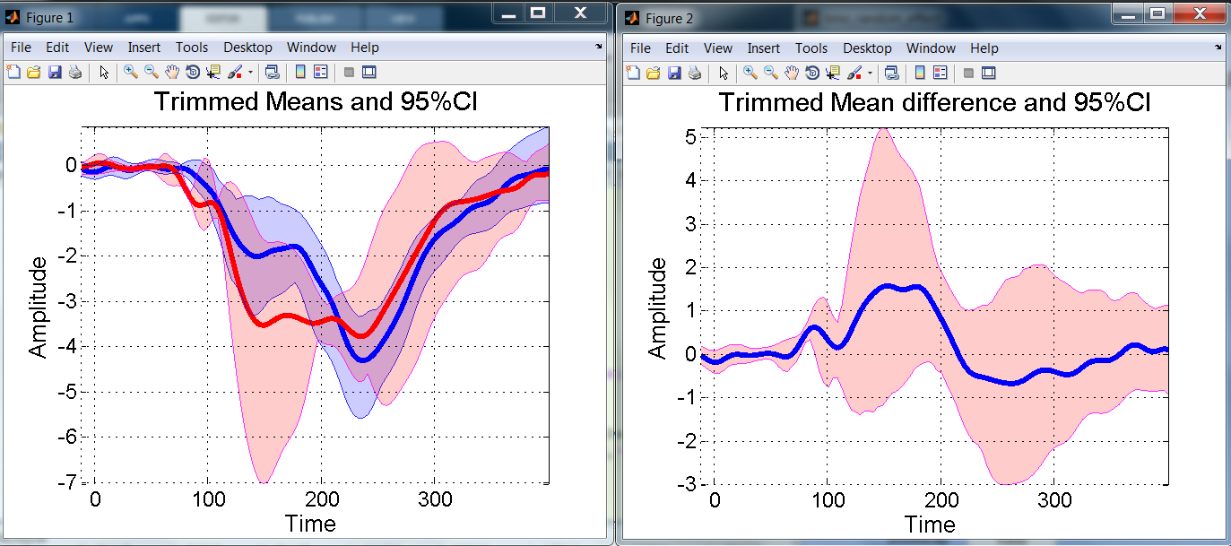
Make and plot a difference
20% trimmed means per group or condition
20% trimmed mean difference

Slide 8
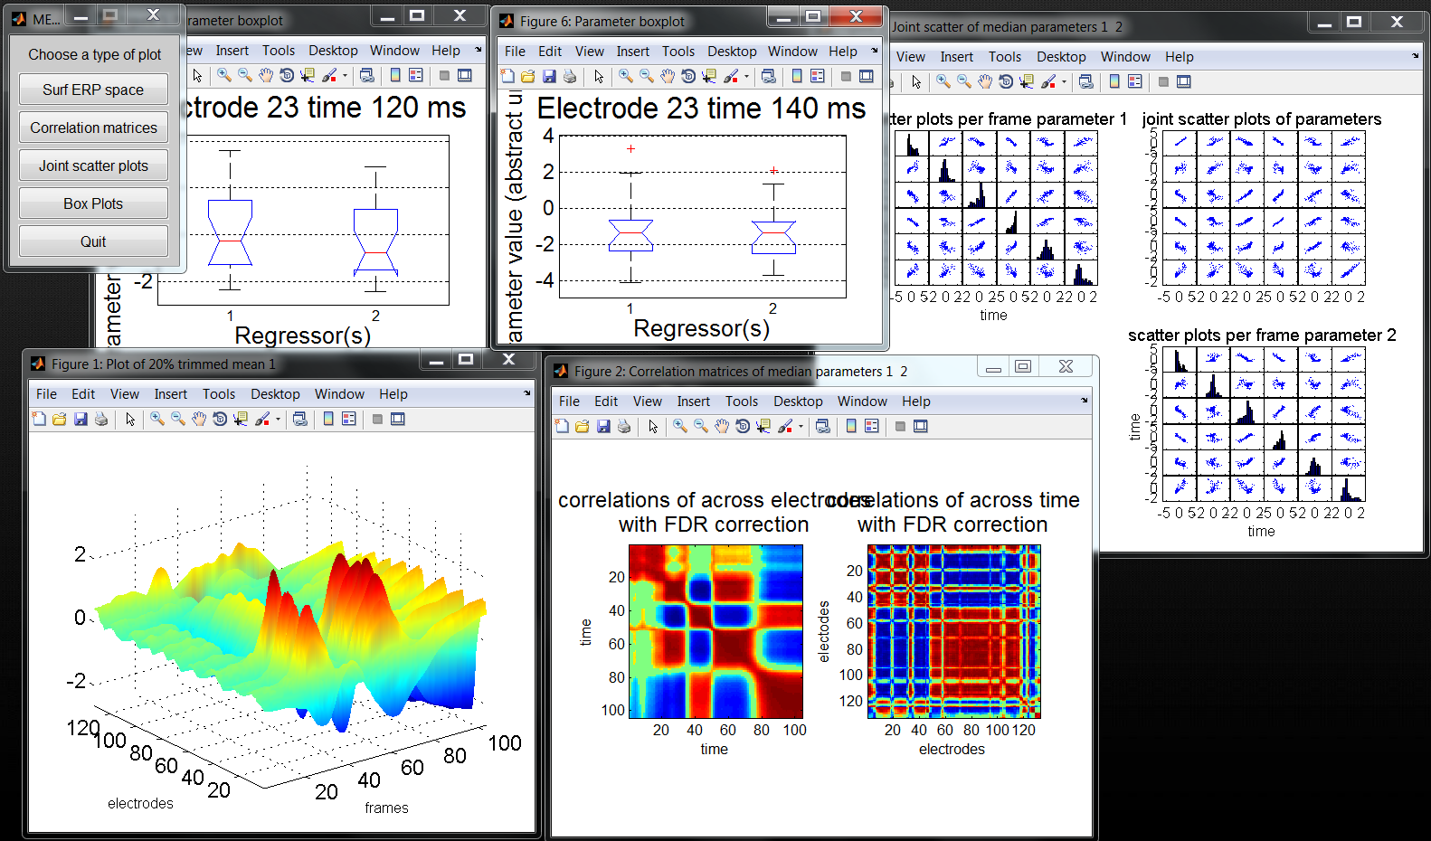
Parameter plots
Some extra visualization tools to explore beta parameters

